Slide 1
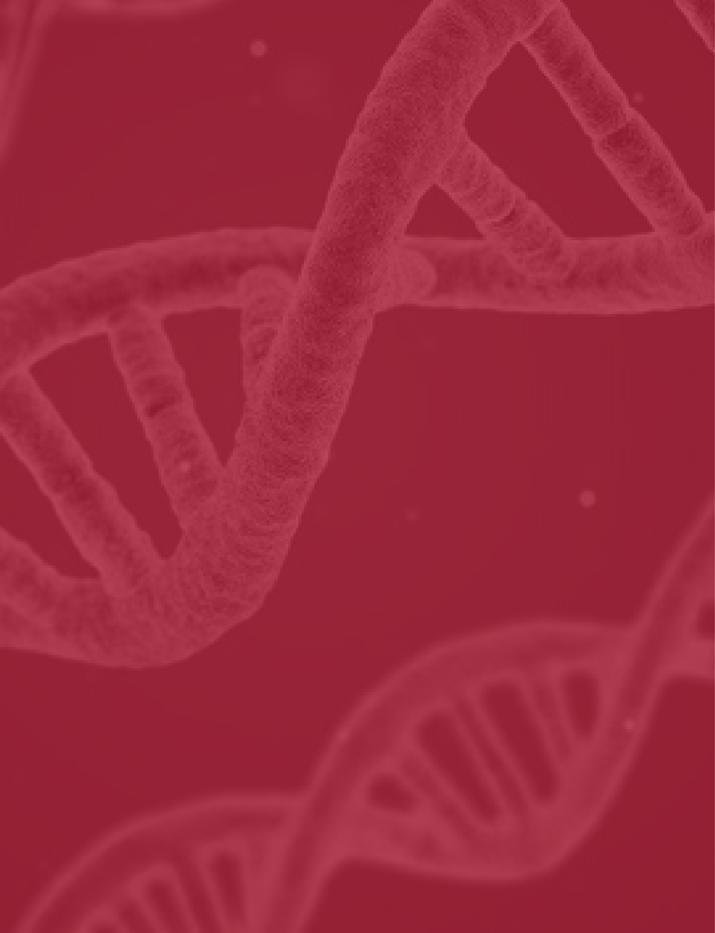

D I S T R I B U T E D C O M P U T I N G
S P R I N G 2 0 2 0
DNA
Translation
Dr. Safwat Hamad

Slide 2

LIST OF KEY CONCEPTS
Introduction
The Techniques used
Sequential Code
Parallel For Code
Function Sections Code
Conclusion
Our Agenda for Today

Slide 3

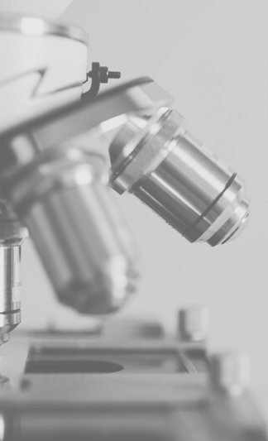
Introduction
TRANSLATING THE DNA SEQUENCE

Slide 4

What does the program do?
Most of the living organisms have similar structure and their DNA sequences can be translated to nearly the same groups of amino acids, these groups of amino acids are all grouped in a table that have 64 entries.
A single amino acid in the protein chain is consisted of three nucleotide codon. Each combination of three codons has a specific name of amino acid, all stored in a table or a scheme.
In this project we take a Human DNA from overlapping chromosome 19-specific cosmids
R29515 and R28253 as in input and translate this DNA to amino acids. Also calculates the frequency of each codon.

Slide 5
The Techniques Used
3 DIFFERENT WAYS OF IMPLEMENTING THE CODE
Sequential Code
Parallel For Code
Function Sections Code

Slide 6
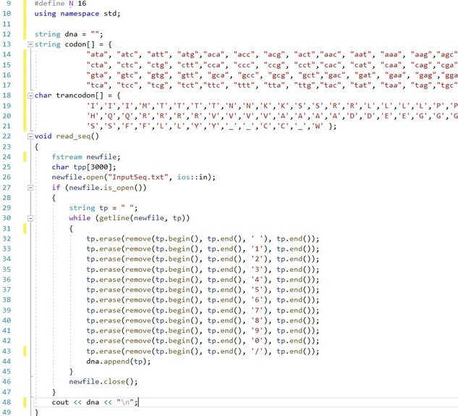
Initialization
BEFORE GOING INTO DETAILS
The schemes we used and how we read the input sequence file

Slide 7
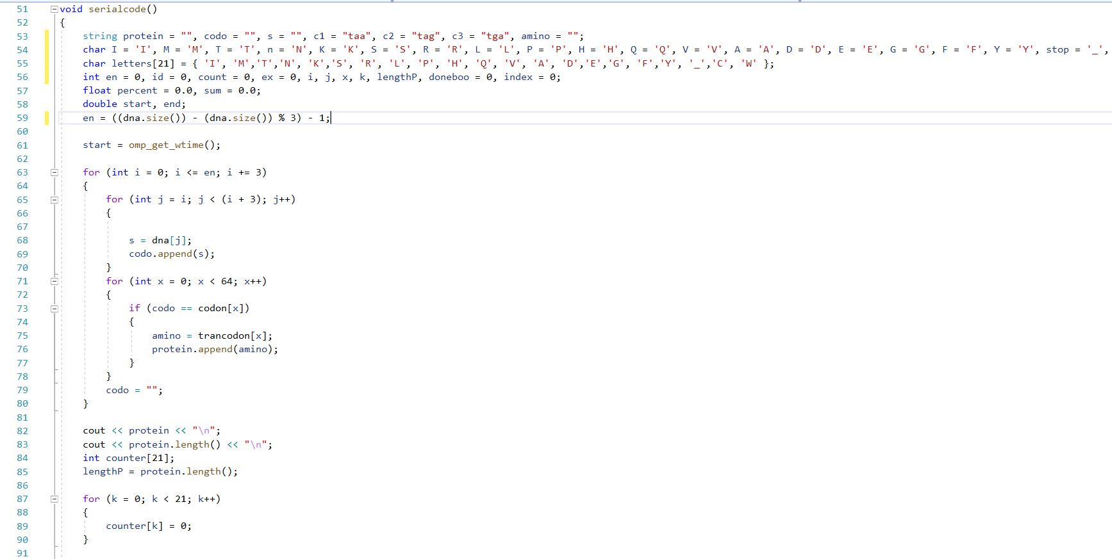

Sequential Code

Slide 8
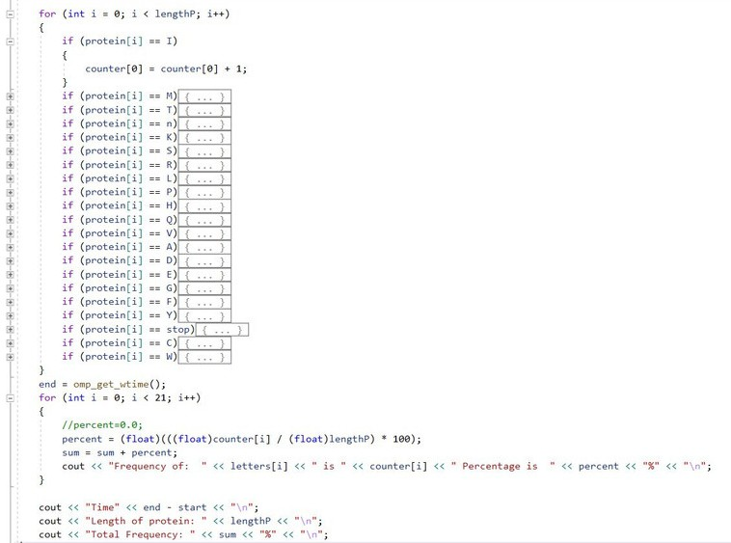
Sequential Code

Slide 9
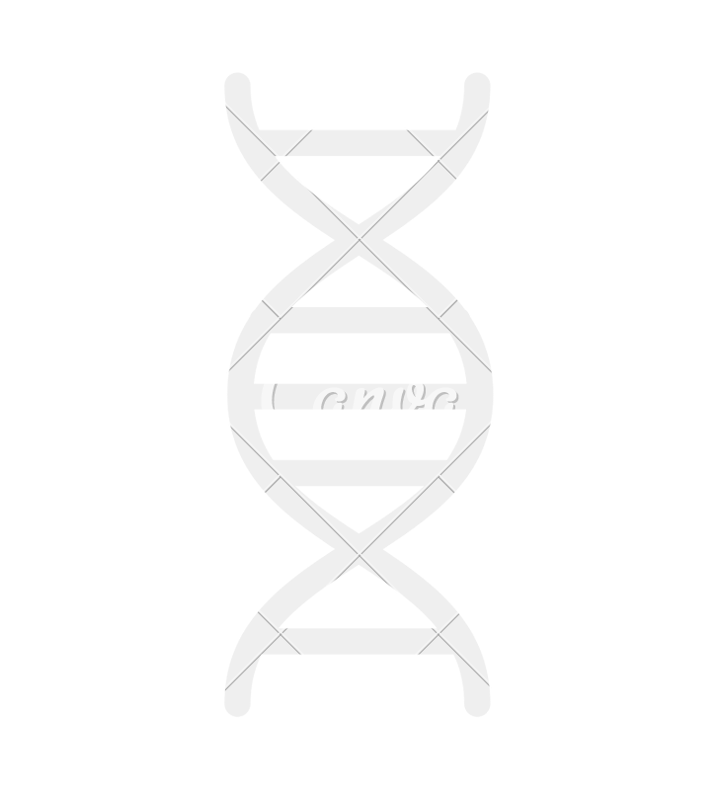

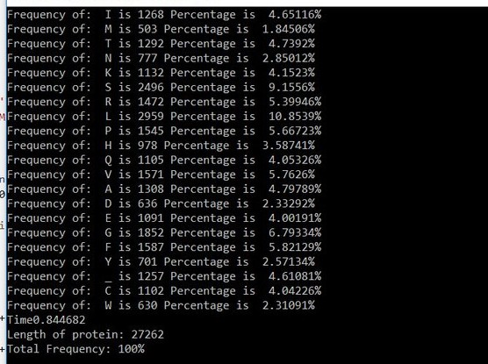
Out-Put Screen
OBSERVING THE TIME
We find that the time taken is quite large (0.84)

Slide 10
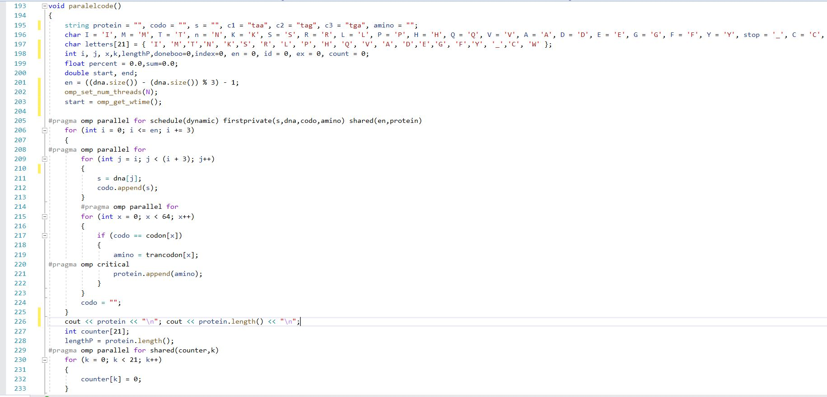
Parallel For Code

Slide 11
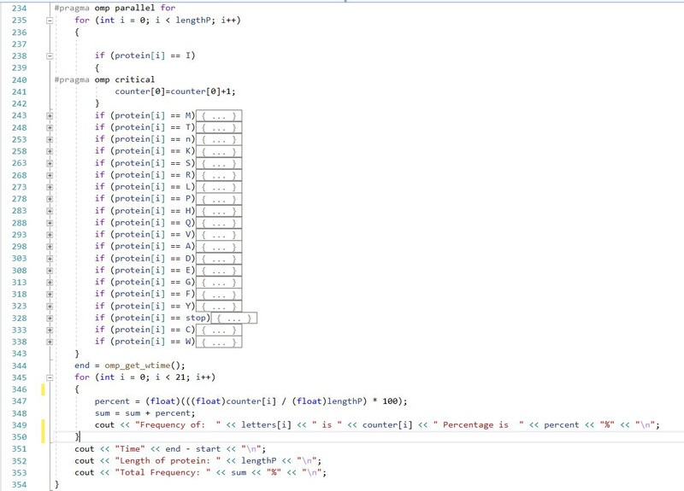
Parallel For Code

Slide 12
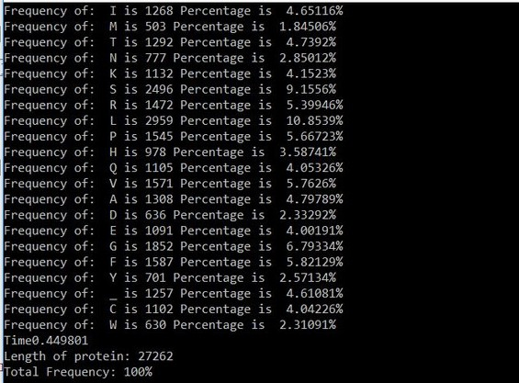
Out-Put Screen
OBSERVING THE TIME
We find that the time taken is smaller than that consumed by the sequential code (0.44)

Slide 13
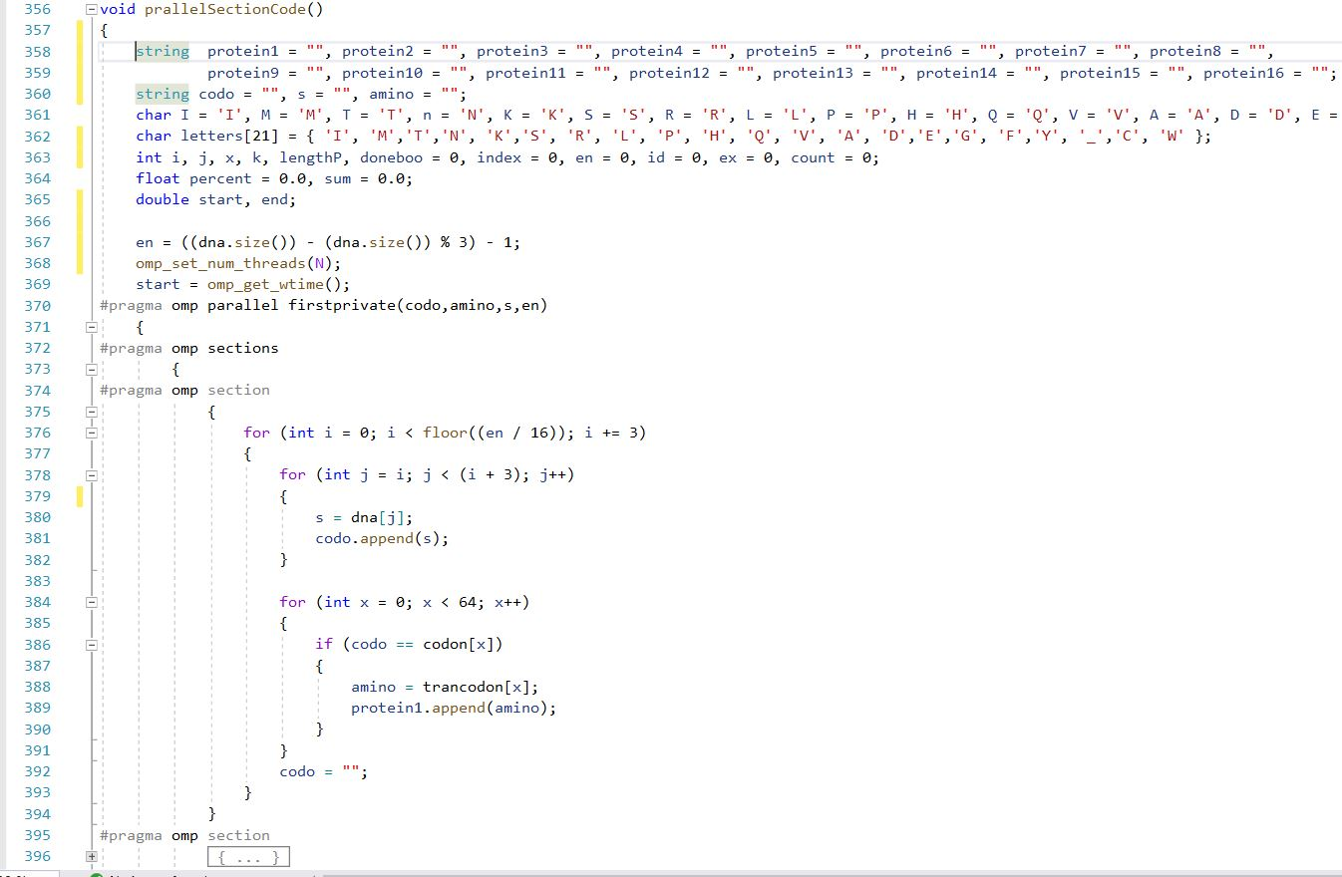
Parallel Section Code

Slide 14
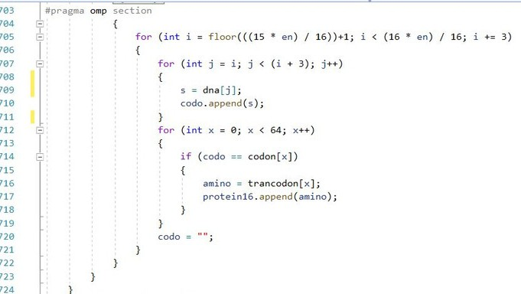
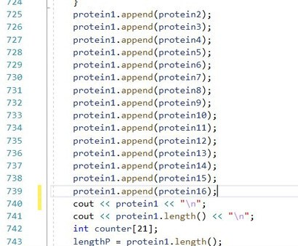
Parallel Section Code

Slide 15
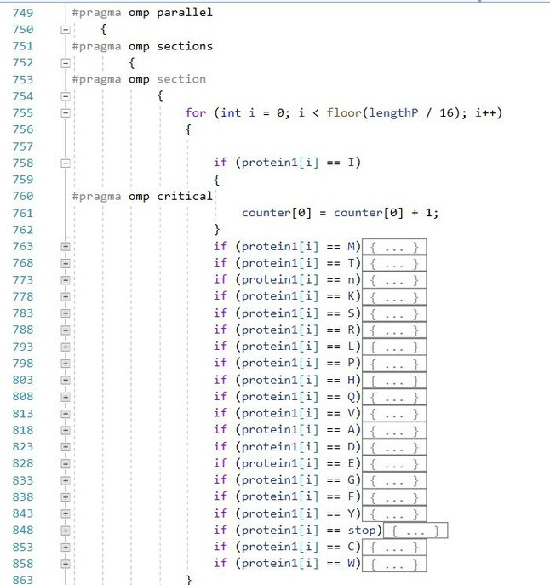
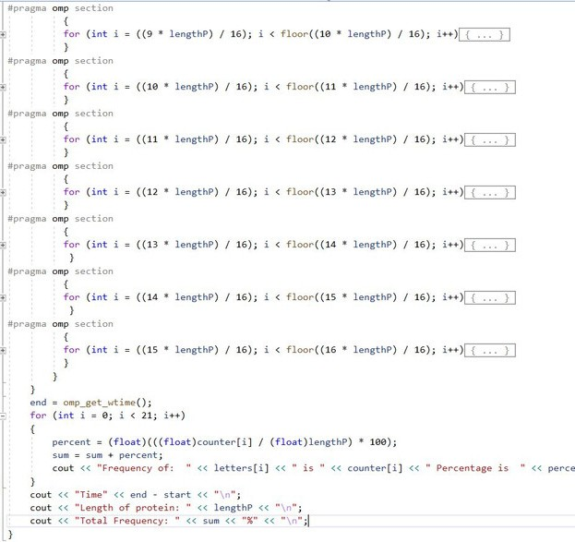
Parallel Section Code

Slide 16
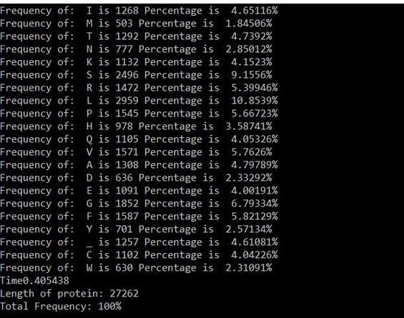
Out-Put Screen
OBSERVING THE TIME
We find that the time taken is smaller than that consumed by the Parallel For code (0.40)

Slide 17
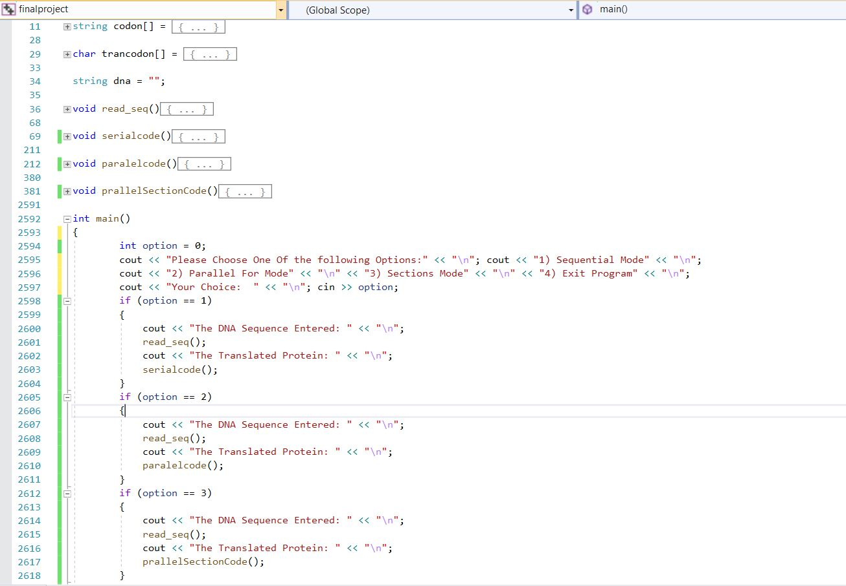

Summary
OVERVIEW

Slide 18

PRESENTED BY:
PRESENTED TO:
Dr. Safwat Hamad Spring 2020
Engy Samy 16p3004 Mayar Wessam 16p3008 Mario Medhat 16p3017

